Slide 1
Backtracking

Slide 2
Definition
It is an algorithmic-technique for solving problems recursively
It tries to build a solution incrementally, one piece at a time, removing those solutions that fail to satisfy the constraints of the problem at any point of time
A solution space has to be made, this space is searched in a depth-first manner beginning at a start node
The typical organization of the solution space is either a graph or a tree

Slide 3
Types
There are, in total, three types of problems in backtracking, namely:
Decision Problem – In this, we search for a feasible solution.
Optimization Problem – In this, we search for the best solution.
Enumeration Problem – In this, we find all feasible solutions.

Slide 4
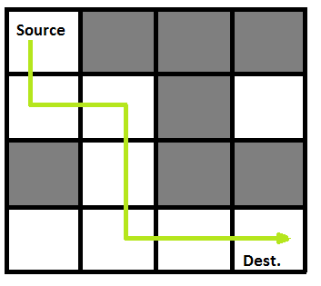
Problem Statement
A Maze is given as N*N binary matrix of blocks where source block is the upper left most block i.e., maze[0][0] and destination block is lower rightmost block i.e., maze[N-1][N-1]
A rat starts from source and has to reach the destination. The rat can move only in two directions: forward and down
In the maze matrix, 0 means the block is a dead end and 1 means the block can be used in the path from source to destination.
Answer to this is implemented in “Rat_in_Maze.py”

